Slide 1
EXERCISE 4

Slide 2
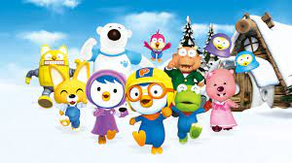
1
Animation: hoạt hình
/ˌæn.ɪˈmeɪ.ʃən/
Her voice was full of animation

Slide 3

2
Proceeding: cách tiến hành, cách hành động
/prəˈsiːding/
His lawyers have decided not to proceed with the case.

Slide 4
3

